Slide 1


Bài giảng điện tử
Unit 2: Days
Lesson 2: Reading

Slide 2


Slide 3


Slide 4
1. sleep
2. chat online

Slide 5
3. have dinner
4. help with the housework

Slide 6
5. wash your face
6. do your homework

Slide 7
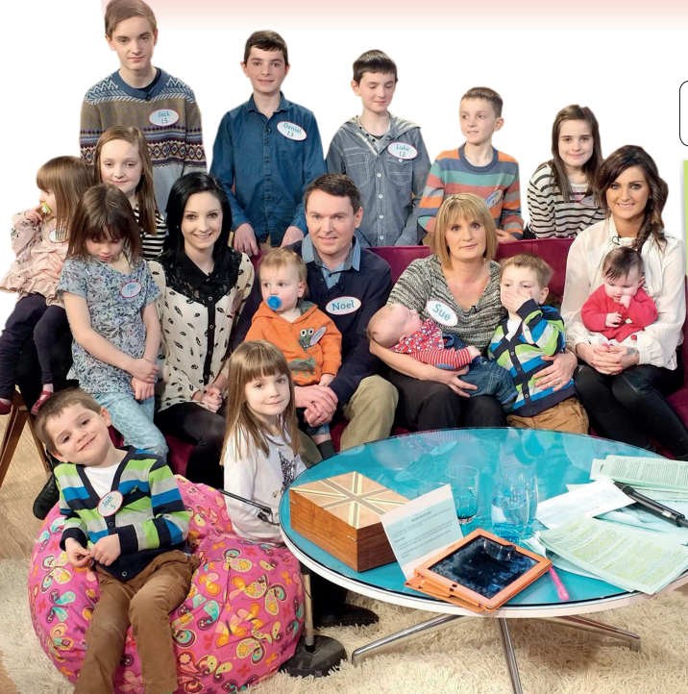
What is the picture about?

Slide 8
UNIT 2: DAYS
Lesson 2
READING • A busy day

Slide 9
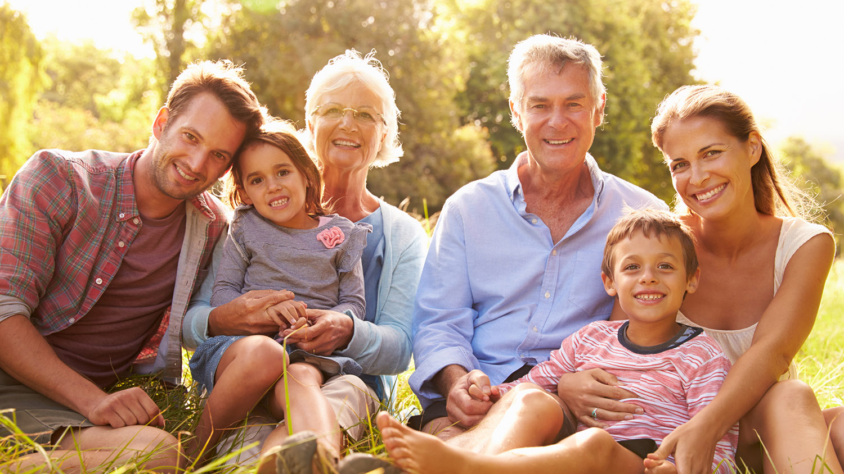
parent (n)

Slide 10
son (n)

Slide 11
daughter (n)
11

Slide 12
grandchildren (n)
12
12

Slide 13
sister (n)
brother (n)

Slide 14
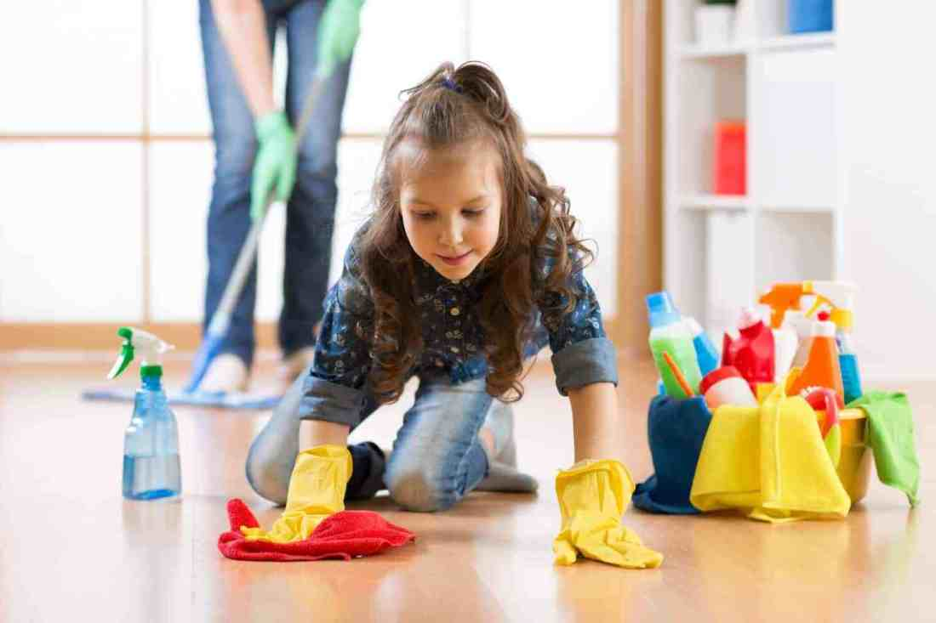
help with housework

Slide 15
- organised (adj) /ˈɔːr.ɡən.aɪzd/
Ex: It’s a big family, and they’re very
organised.

Slide 16
New words
son (n) /sʌn/
daughter (n) /ˈdɑː.t̬ɚ/
grandchildren (n) /ɡrændˈtʃɪl.drən/
- parent (n) /ˈper.ənt/
- brother (n) /ˈbrʌð.ɚ/

Slide 17
New words
sister (n) /ˈsɪs.tɚ/
organised (adj) /ˈɔːr.ɡən.aɪzd/
help with the housework

Slide 18
ACTIVITY 1
son, brother,
father, uncle,
grandfather,
grandson
daughter, sister,
Granddaughter,
mother, aunt
grandmother,

Slide 19
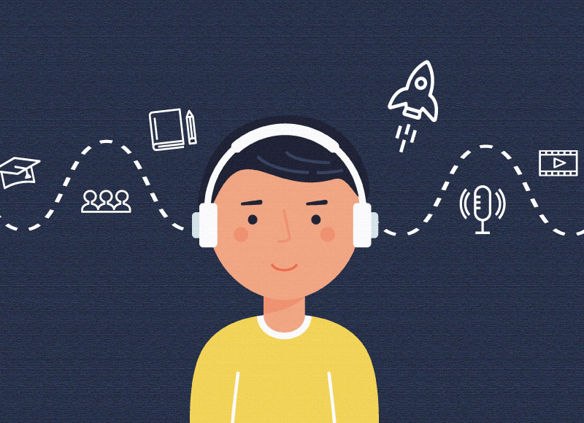
ACTIVITY 2
Listen and choose the best title.

Slide 20

A. Big family, big problems
B. An easy life for the Radfords
C. Happy house

Slide 21
has breakfast / doesn’t have breakfast with his family.
Noel

Slide 22
How to predict
the meanings of words:
• First, look at the context.
• Then, scan the text to find the meanings of the words.

Slide 23
Name (a family member)
doesn’t have
breakfast
Noel has breakfast /
with his family.

Slide 24
ACTIVITY 3
1. doesn’t have breakfast
2. don’t help
3. at home
4. always

Slide 25
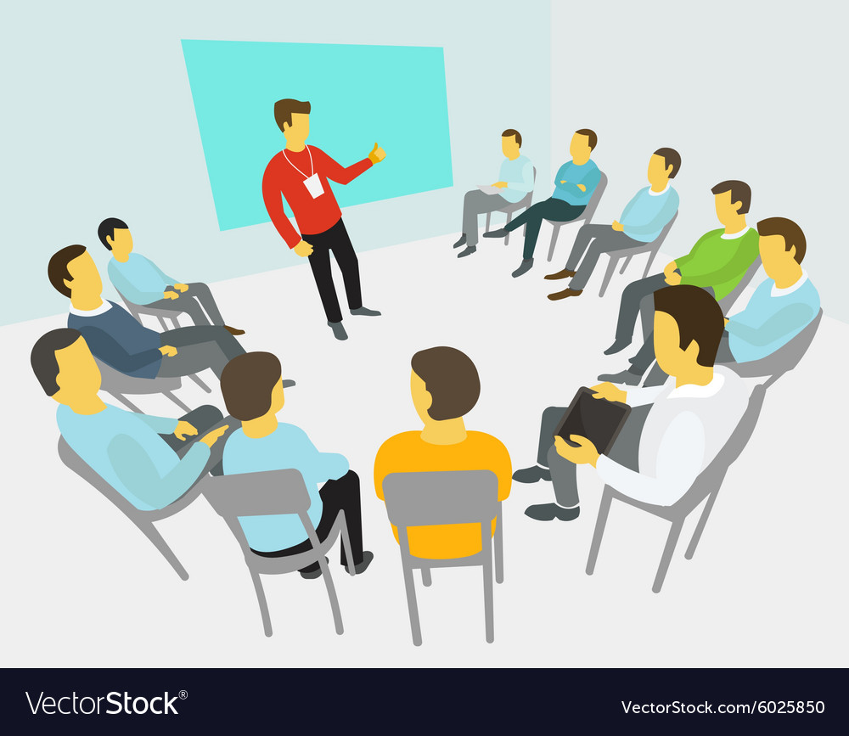

Slide 26
ACTIVITY 4
Talk about the Radfords and your family routines. What are the differences?

Slide 27
the Radfords | my family
Noel gets up at 4.45 a.m …… | My father ….. ……

Slide 28
speaking
There are some differences between my family and the Radfords routines:
First, …………….
Second, ………….
Finally, …………

Slide 29
HOMEWORK
- Do exercise in workbook page 22
- Prepare for the next lesson:
Language Focus - Present simple: affirmative and negative.

Slide 30



www.phuongnam.edu.vn

